Slide 1

Final Project The Battle of Neighborhood by Jiajing Shi
Picture Source: https://www.google.com/search?q=food&rlz=1C1CHBD_enUS737US737&source=lnms&tbm=isch&sa=X&ved=0ahUKEwjs4uTevNPjAhWTWc0KHaB-DJEQ_AUIEigC&cshid=1564174874529606&biw=1279&bih=708&dpr=1.25#imgdii=EQYf4Givi2DsKM:&imgrc=DOALplamMwZj5M:

Slide 2
Introduction
Goal: choose a location in New York for a sit down restaurant
Target Customers: average income
Preference: larger population and higher GDP area

Slide 3
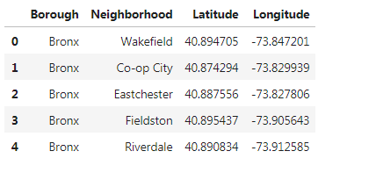
New York Neighborhood Location Data
Source: https://cocl.us/new_york_dataset/newyork_data.json

Slide 4
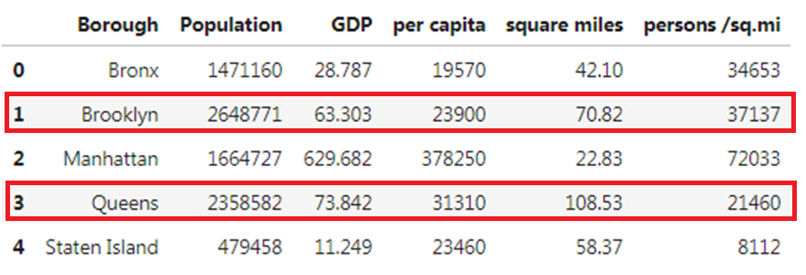
Population & Capita Dataset
Narrow down our option to 2 boroughs: Brooklyn and Queens
Source from: https://en.wikipedia.org/wiki/Boroughs_of_New_York_City

Slide 5
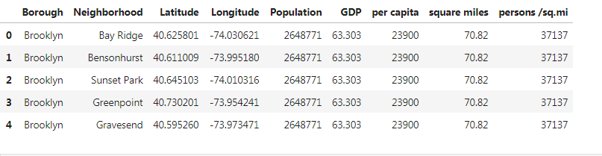
Only keep the data for Brooklyn and Queens Merge the data sets together
Data Processing

Slide 6
Generate Maps
Tool: FourSquare
Area: Brooklyn and Queens
Maps: neighborhoods, current restaurants and trending

Slide 7
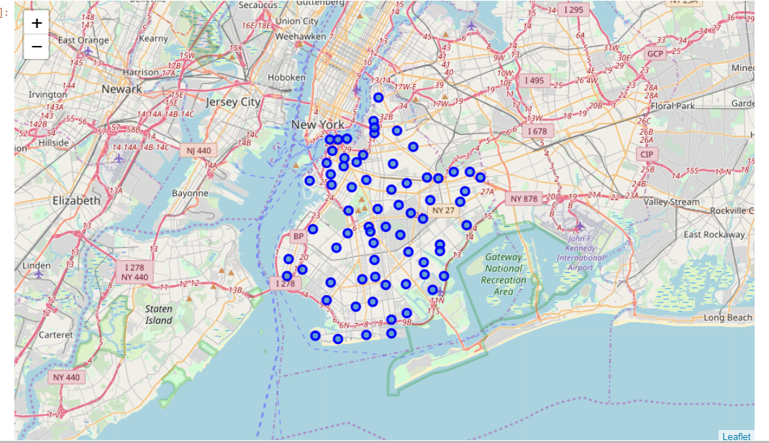
Brooklyn Neighborhoods

Slide 8
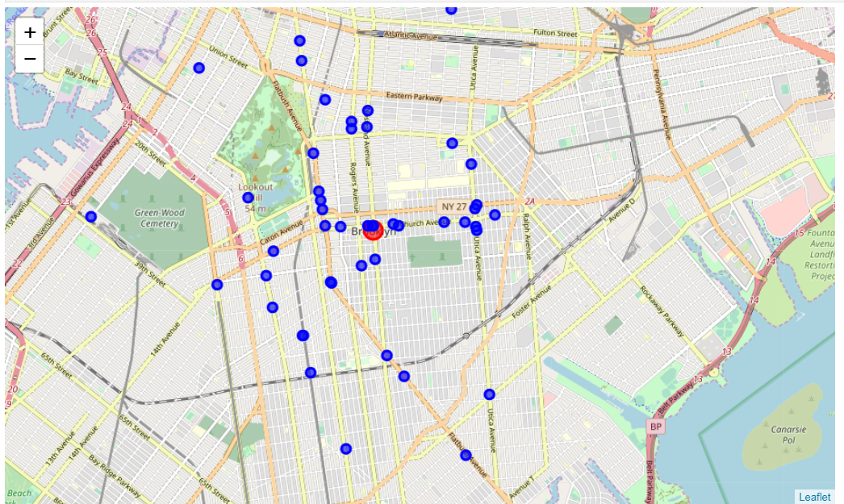
Brooklyn Current Restaurants

Slide 9
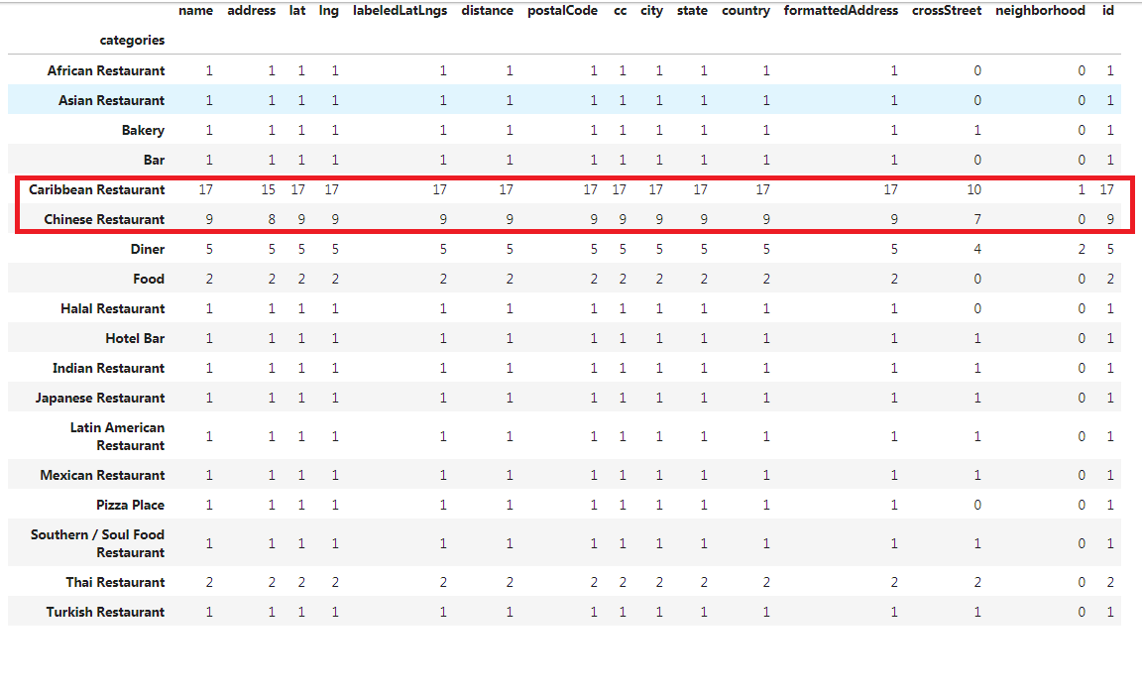
Brooklyn Restaurants Categories

Slide 10
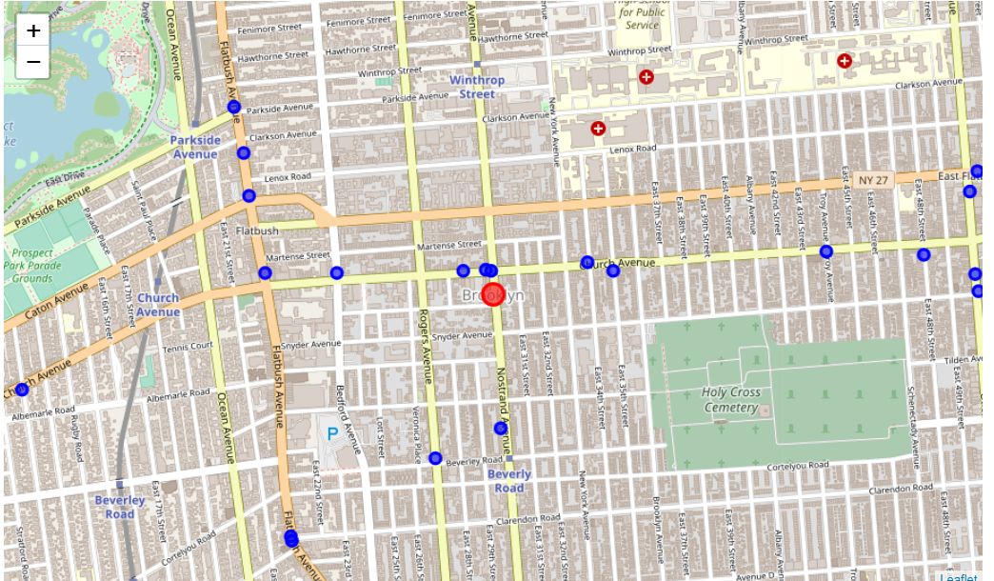
Brooklyn Restaurant Trending

Slide 11
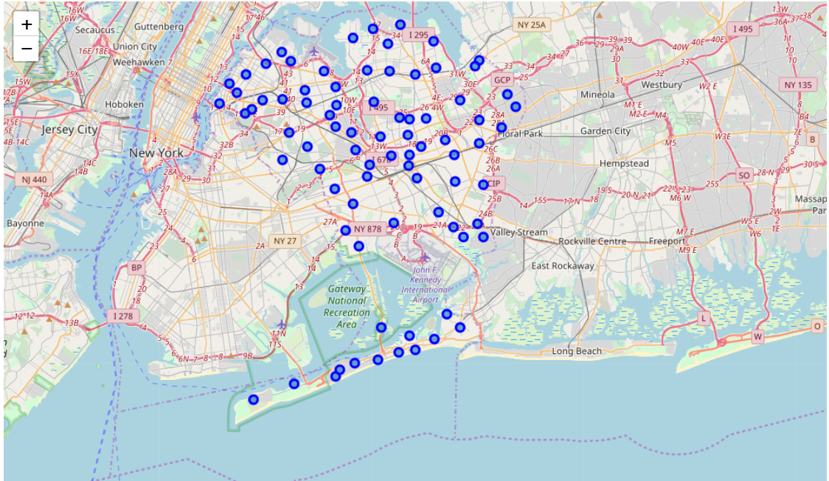
Queens Neighborhoods

Slide 12
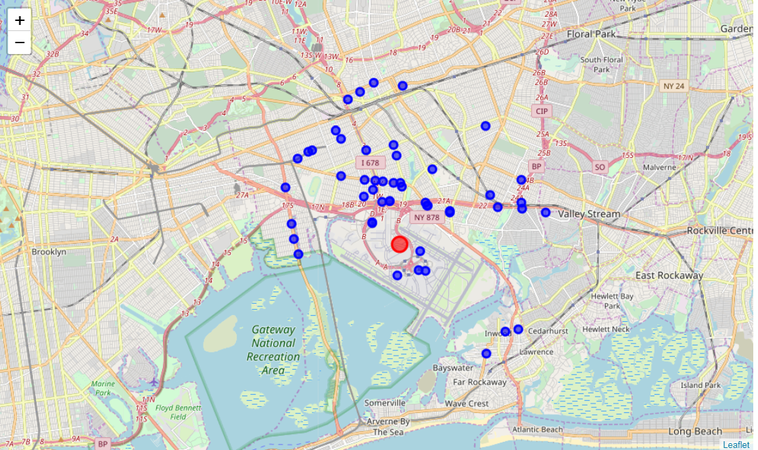
Queens Current Restaurants

Slide 13
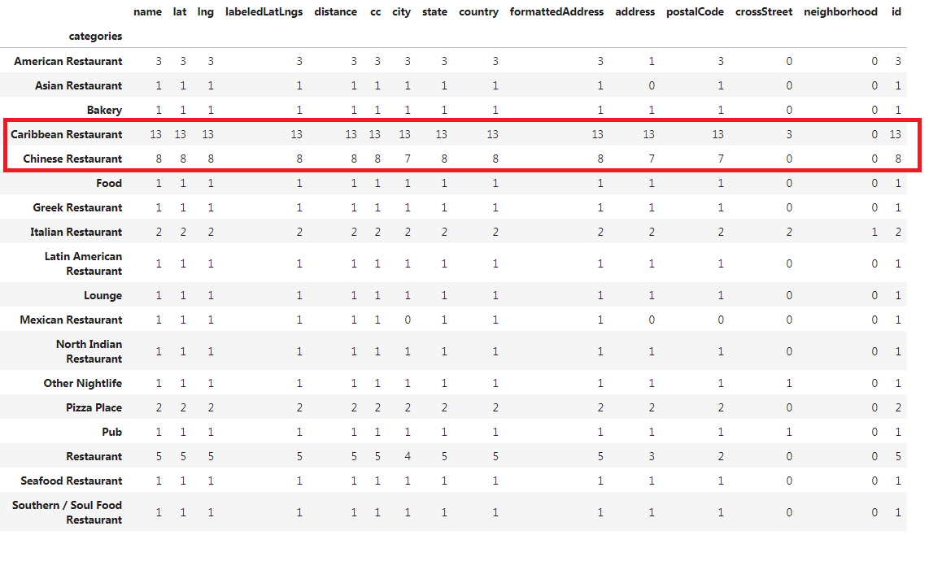
Queens Restaurants Categories

Slide 14
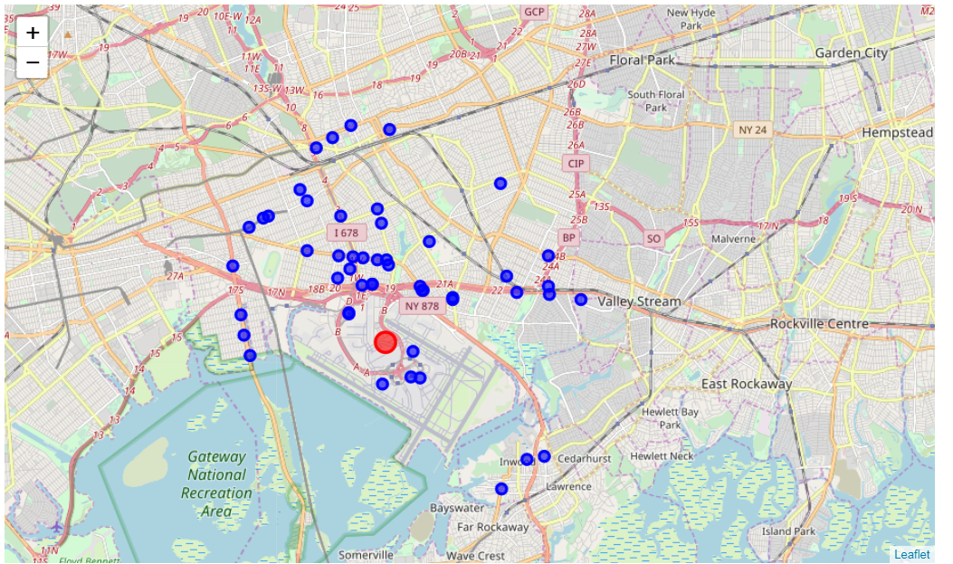
Queens Restaurants Trending

Slide 15
Comparison: Brooklyn VS. Queens
Neighborhoods Distribution: Brooklyn is more evenly
Current Restaurants: Both similar types and numbers
Restaurants Diversity: Brooklyn is better
Trending: Brooklyn is more clear view

Slide 16
Summary
From the current restaurant categories of Brooklyn and Queens, we can clearly tell that Caribbean and Chinese restaurants are the most popular types in New York. Our restaurant should be either Caribbean or Chinese
Brooklyn will be our choice for Location

Slide 17
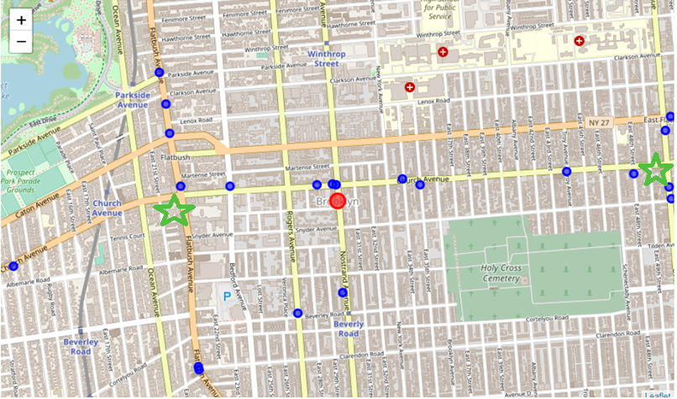
2 Possible Locations

